Slide 1


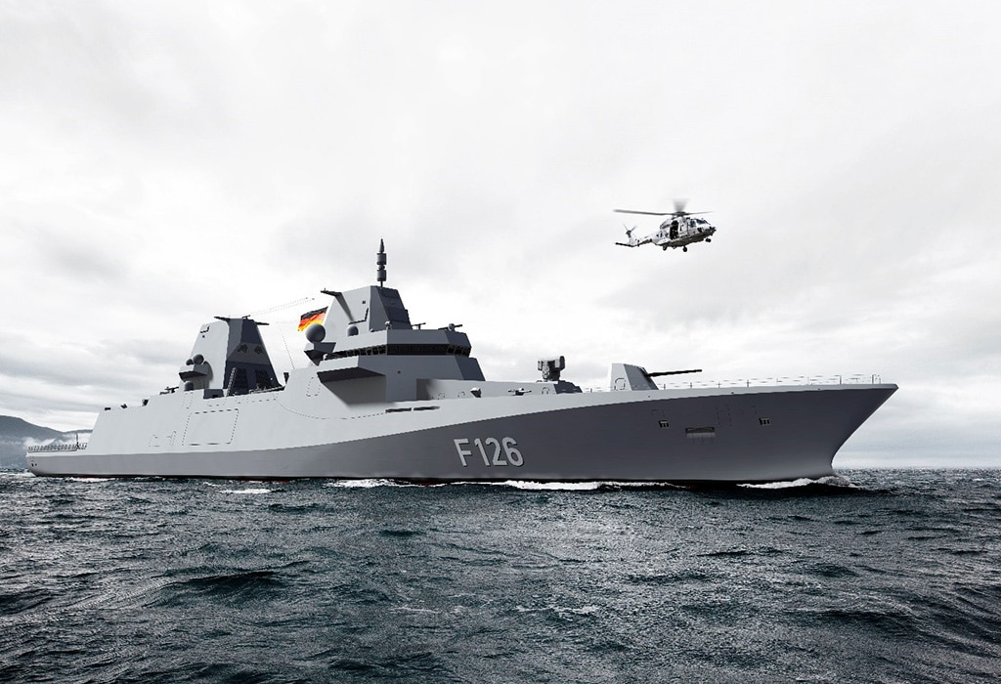
Analysis on condition and Maintenance of Naval Propulsion Plants DataSet
CAPSTONE PROJECT
Group 2
1.SRIVANI
2.VAISHALI
3.ANKITA

Slide 2
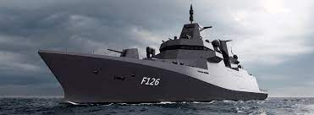
CONTENT
Introduction
Data Information
Data Importing
Data Exploration
Data Modelling

Slide 3
INTRODUCTION
BACKGROUND
Data has been generated from a sophisticated simulator of a Gas Turbines
The different blocks forming the complete simulator have been developed and fine tuned over the year on several similar real propulsion plants
OBJECTIVE
To train the data and find the most efficient ML algorithm to perform Condition-Based Maintenance
PATH TAKEN
The team followed standard machine learning development process.

Slide 4
DATA INFORMATION
This dataset constitutes 11934 rows and 18 columns with no null values.
This dataset contains numeric data and datatype is “float”.
The columns in the dataset depicts about condition of the Naval Propulsion plant.
The target variable is GT compressor decay state coefficient.

Slide 5
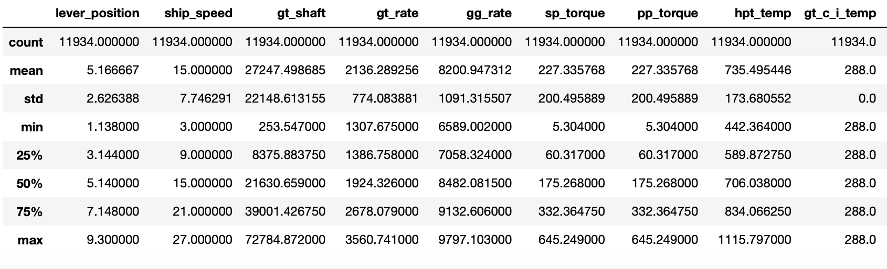
Data description
There are no duplicate values in the data
Four columns are dropped from the data. They are GT compressor inlet air pressure , GT compressor inlet air temperature , Starboard Propeller Torque and GT turbine decay state coefficient
There are no null values in the data
There are no duplicate values in the dataset
Four columns are dropped from the data. They are gt_c_i_pressure , gt_c_temperature , sp_torque and gt_turbine_decay_coefficient.

Slide 6
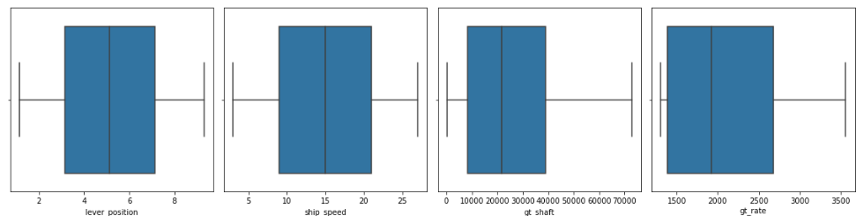
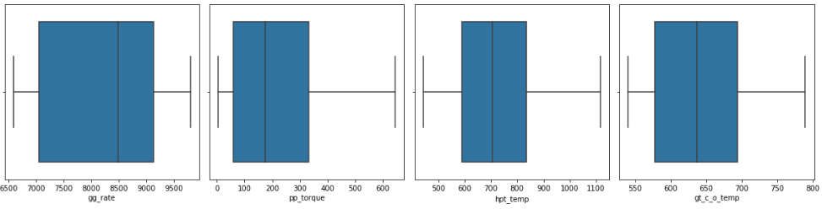
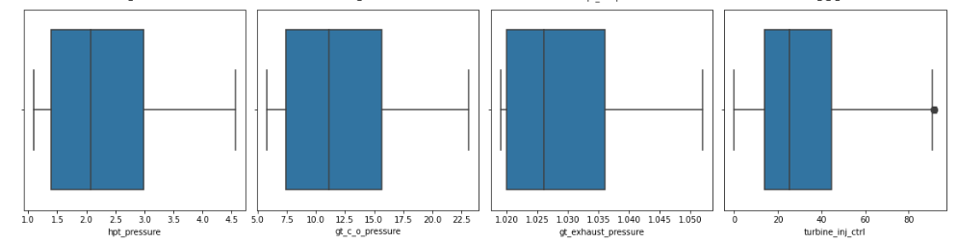
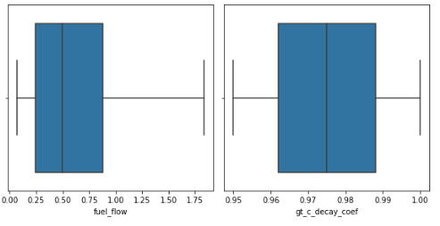
BOX PLOT

Slide 7
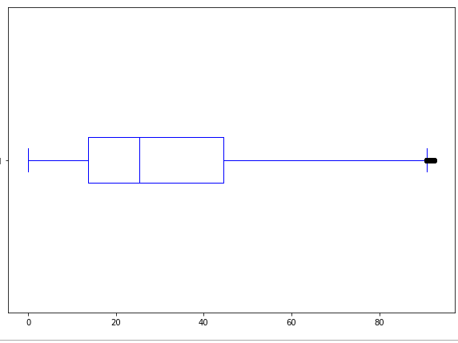
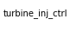
Outliers REMOVAL
The boxplot represents outliers in dataset
The outliers are removed using Z score method

Slide 8

EXPLORATORY DATA ANALYSIS
DATA EXPLORATION
HEATMAP
DIST PLOT
PAIR PLOT
VIOLIN PLOT

Slide 9
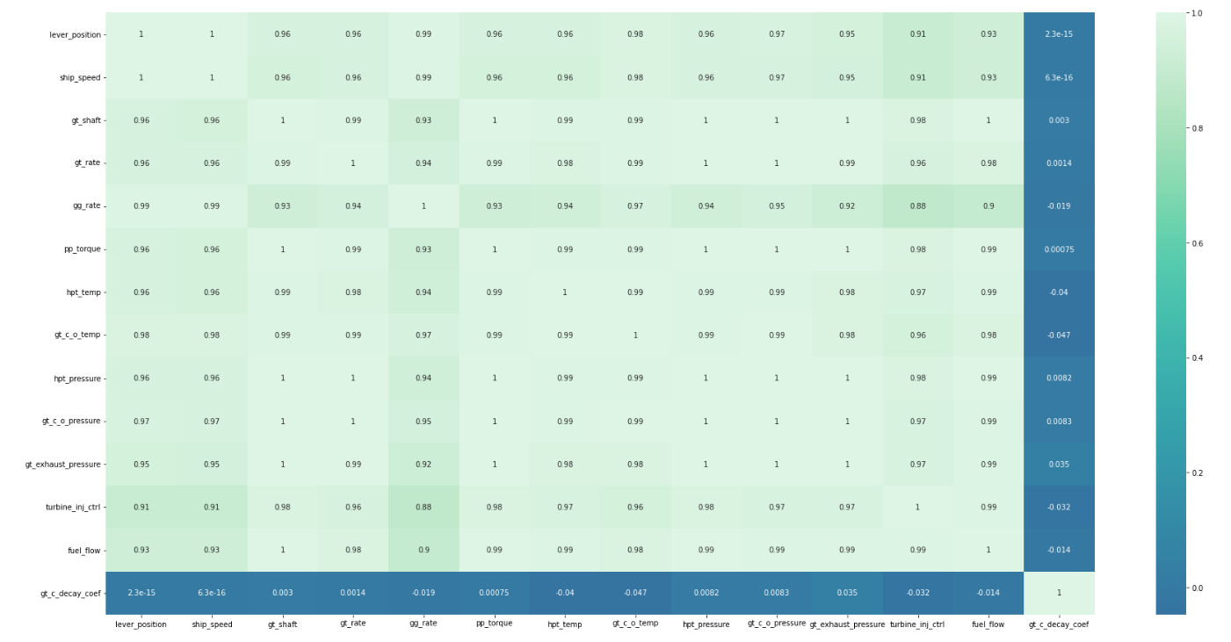
correlation Heatmap

Slide 10
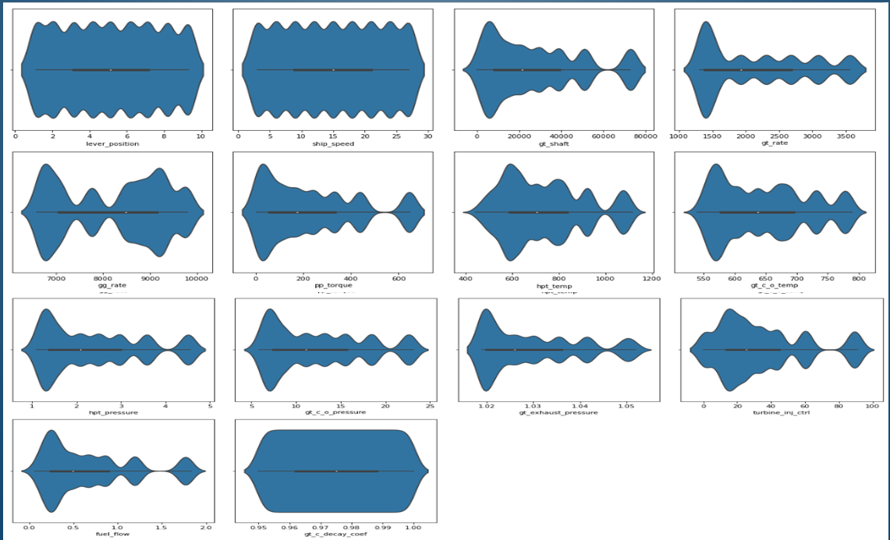
VIOLIN PLOT

Slide 11
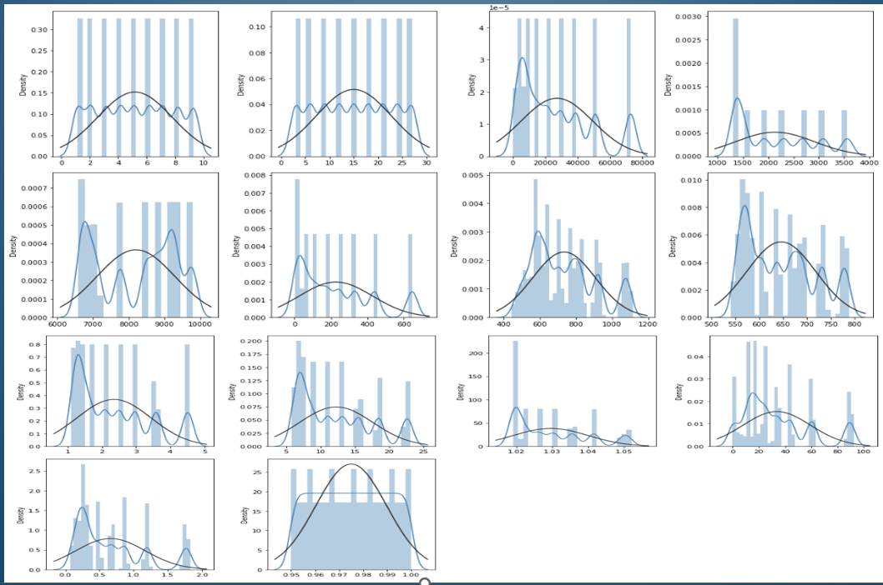
DIST PLOT

Slide 12
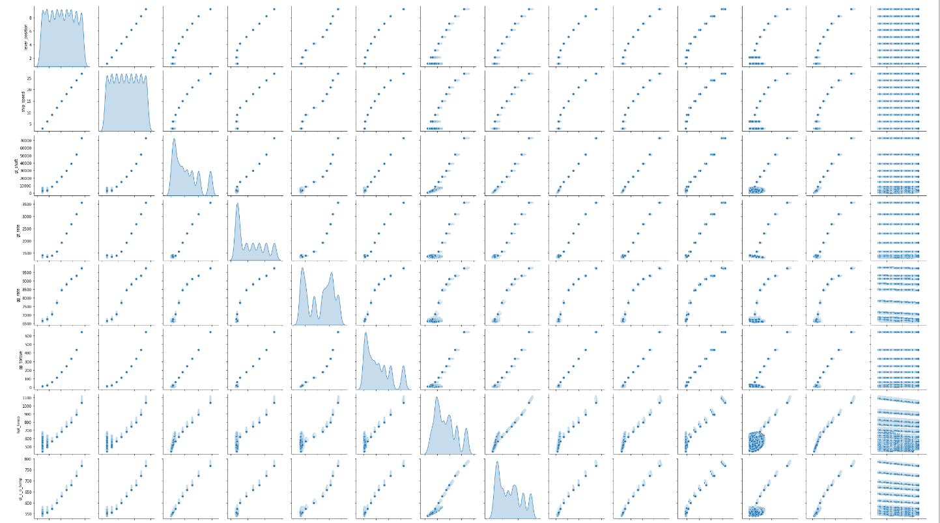
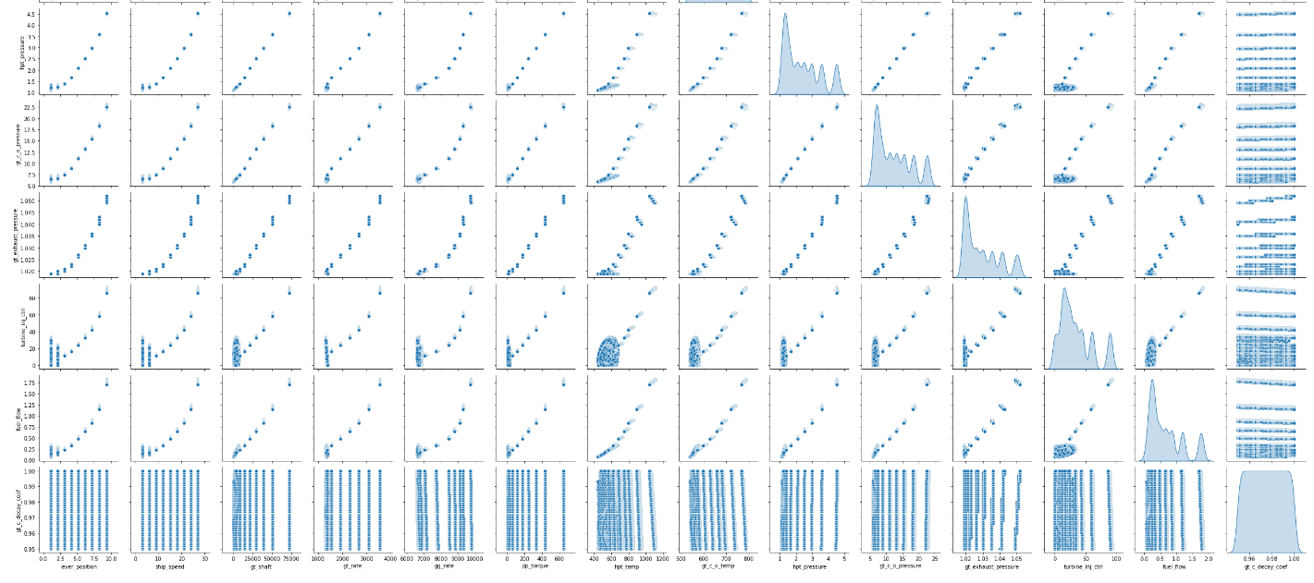
PAIR PLOT

Slide 13
MODEL BUILDING
Linear regression
Random Forest Regressor
Bagging Regressor
KNN Regressor
SV Regression
Decision Tree Regressor

Slide 14
Linear Regression
Decision Tree Regressor
Train-Test Proportion | MAE
70 - 30 | 0.00457
75 - 25 | 0.00456
80 - 20 | 0.00459
60 - 40 | 0.00457
Train-Test Proportion | MAE
70 - 30 | 7.5627547555e-18
75 - 25 | 7.4428374792e-18
80 - 20 | 7.1775895271e-18
60 - 40 | 5.9542639834e-18
For 75 – 25 ratio we got least MAE score i.e 0.00456
For 70 - 30 ratio we got least MAE score i.e 7.5627547555e-18
Notes:
It looks like you are assigning the dependent variable gt_c_decay_coef to y and the independent variables (all other variables) to x using the drop function to remove the dependent variable from the dataset.
This is a common practice in machine learning and statistical modeling, where the goal is to use the independent variables to predict the dependent variable. Once you have x and y defined, you can use various machine learning or statistical techniques to build a model that predicts y based on x.
Note that the specific techniques and algorithms you use will depend on the nature of your data, the problem you are trying to solve, and other factors. It's important to carefully consider the appropriateness of different models and techniques for your specific situation.

Slide 15
Random Forest Regressor
KNN Regressor
Train-Test Proportion | MAE
70 - 30 | 0.00021
75 - 25 | 0.00020
80 - 20 | 0.00019
60 - 40 | 0.00022
Train-Test Proportion | MAE
70 - 30 | 0.00166
75 - 25 | 0.00161
80 - 20 | 0.00156
60 - 40 | 0.00023
For 80-20 ratio we got least MAE score i.e 0.00019
For 60-40 ratio we got least MAE score i.e
0.00023

Slide 16
Bagging Regressor
SV Regression
Train-Test Proportion | MAE
70 - 30 | 0.00020
75 - 25 | 0.00019
80 - 20 | 0.00018
60 - 40 | 0.01277
Train-Test Proportion | MAE
70 - 30 | 0.01276
75 - 25 | 0.01277
80 - 20 | 0.01275
60 - 40 | 0.01277
For 80-20 ratio we got least MAE score i.e
0.00018
For 80-20 ratio we got least MAE score i.e
0.01275

Slide 17
SUMMARY
ALGORITHM | MAE | RATIO
Linear regression | 0.00456 | 75 - 25
Decision Tree Regression | 7.5627547555e-18 | 70 – 30
Random Forest Regressor | 0.00019 | 80 - 20
KNN Regressor | 0.00023 | 60 - 40
Bagging Regressor | 0.00018 | 80 - 20
SV Regressor | 0.01275 | 80 – 20

Slide 18
CONCLUSION
The CBM of Naval Propulsion dataset is a regression based data
So we have applied six algorithms of machine learning with respect to regression such as Linear regression, Decision tree, Random forest , KNN regressor, Bagging Regressor and SV Regression
Among all the algorithms in Decision Tree Regressor with 70 – 30 performed well and gavel east MAE value when compared to others.
So we can conclude Decision Tree Regressor fits good and can be used for further usage of model.
LINK TO COLAB NOTEBOOK-
https://colab.research.google.com/drive/1Y4SFoKWupmFsNCNjNyTUH_o4ARtmVD4A?usp=sharing

Slide 19
THANK YOU

Slide 20
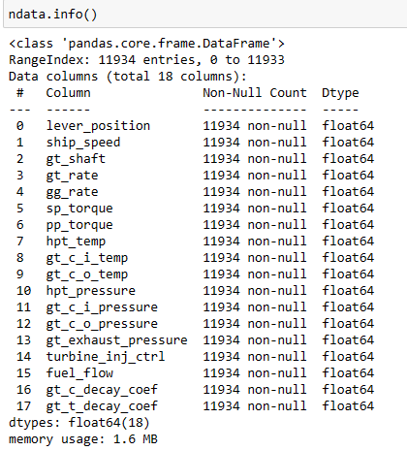
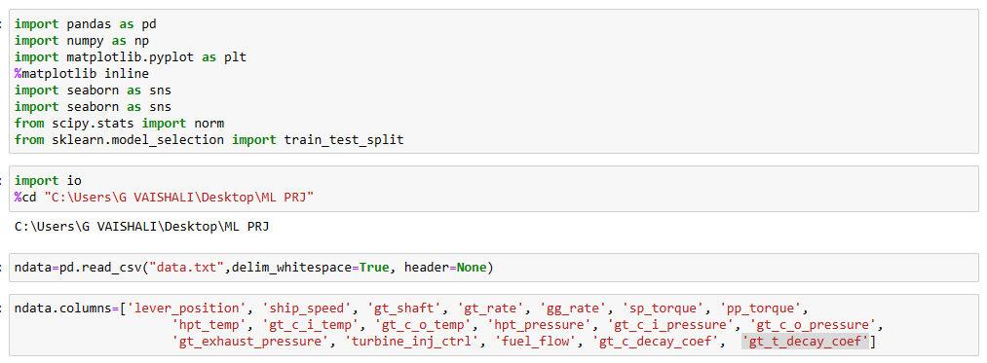
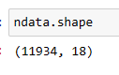
APPENDIX
Data importing

Slide 21
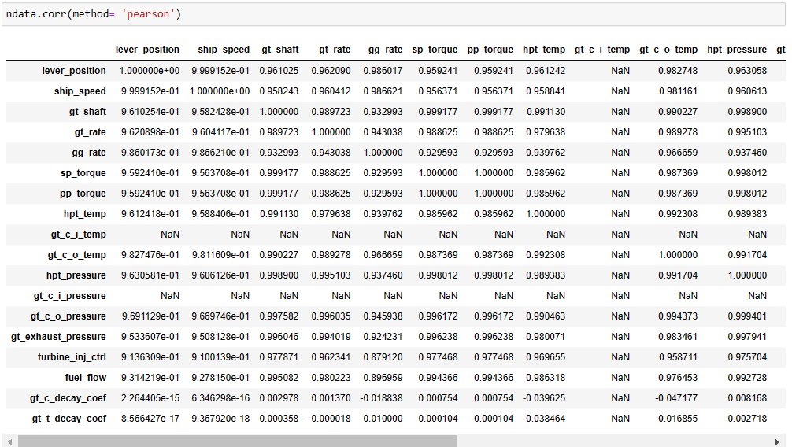
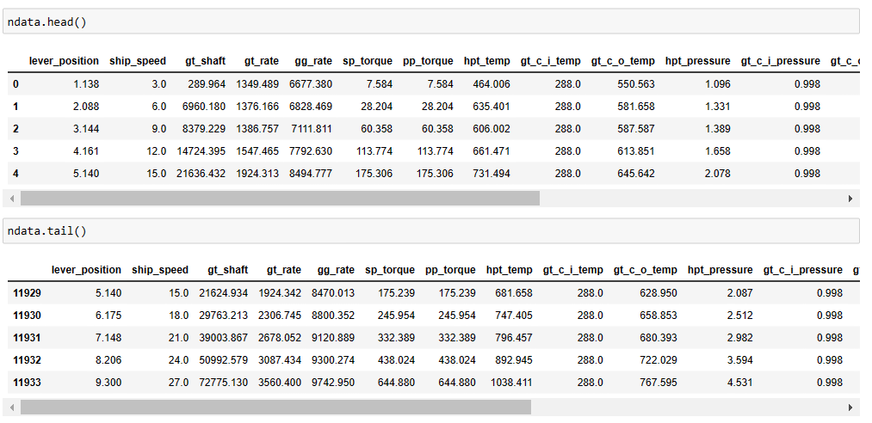
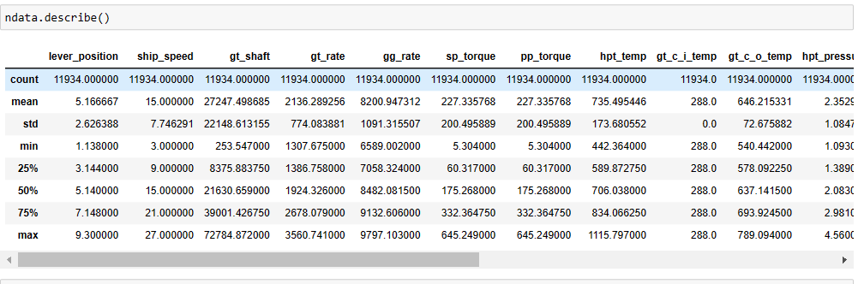
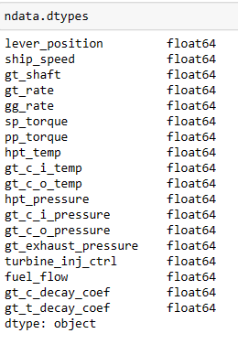

Slide 22
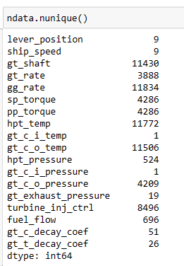
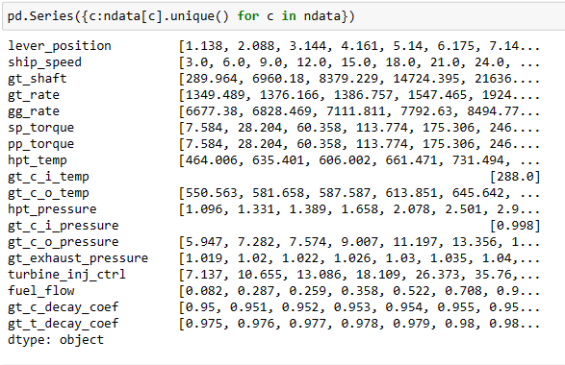
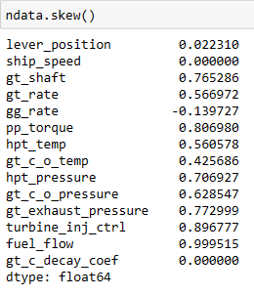
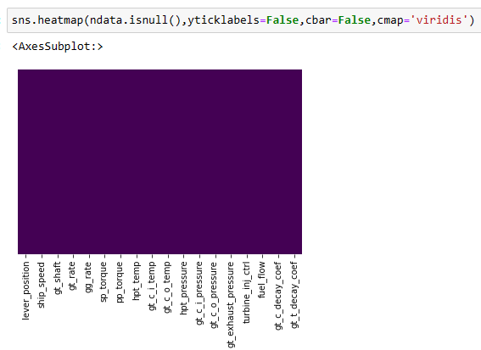
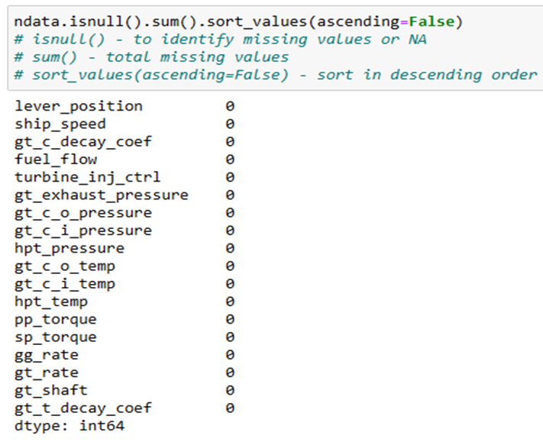

Slide 23
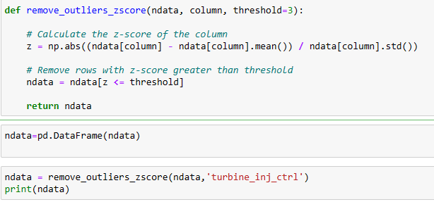
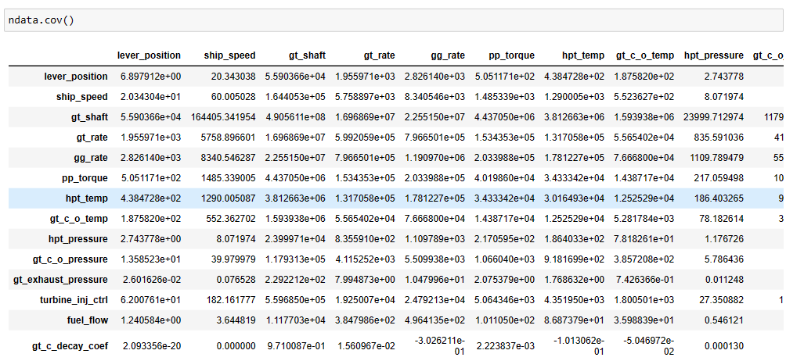
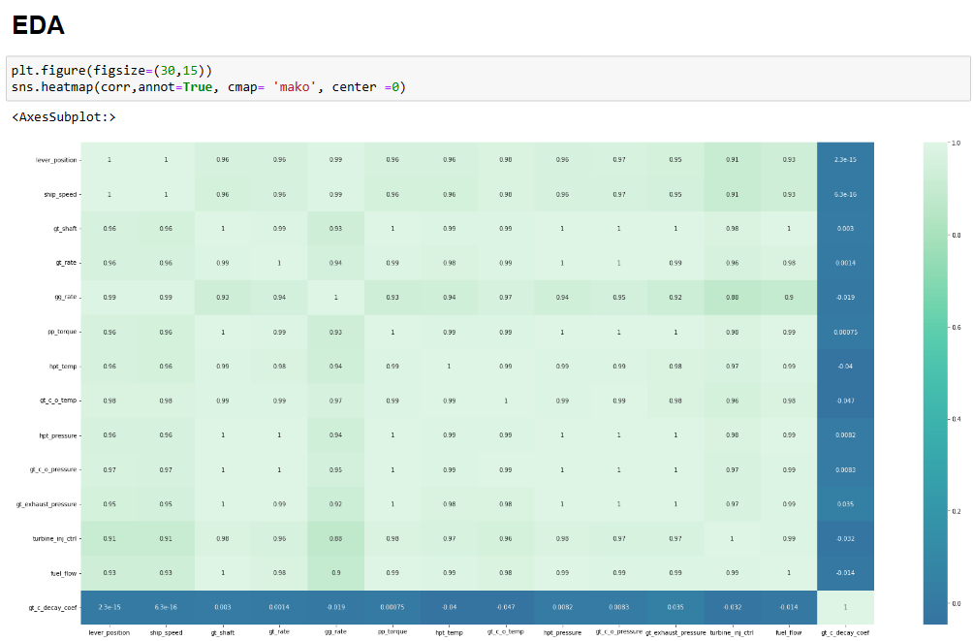
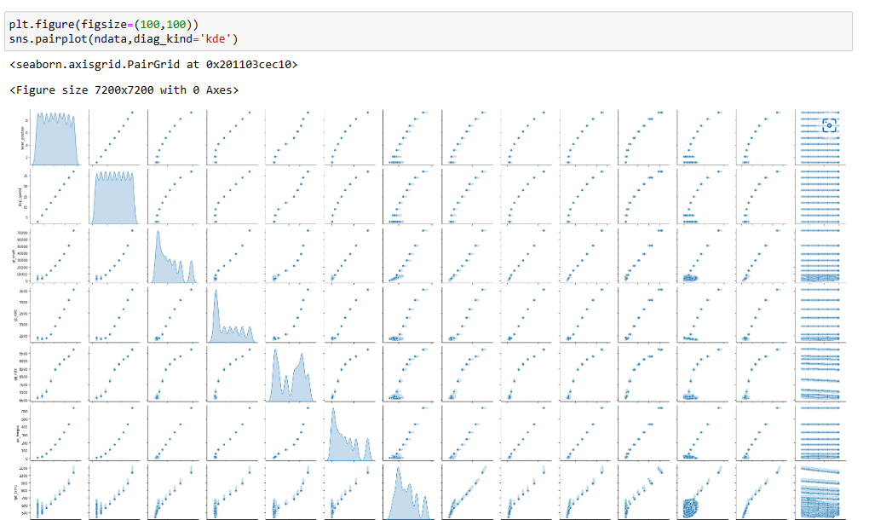

Slide 24
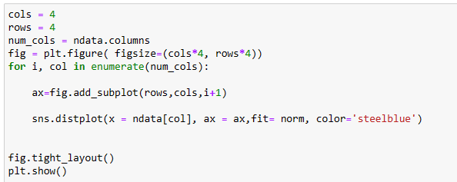
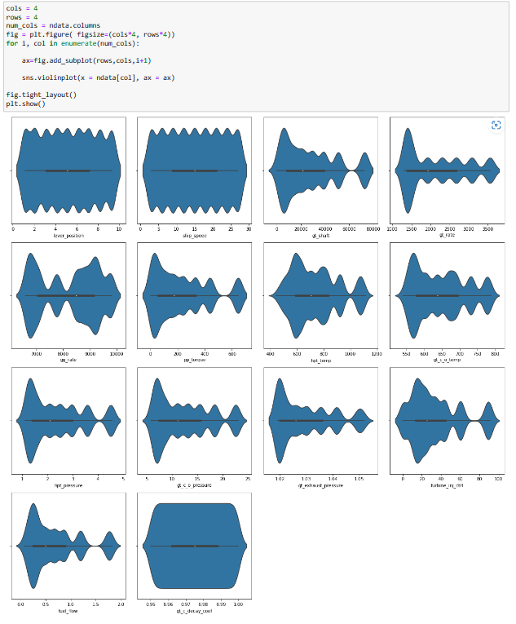
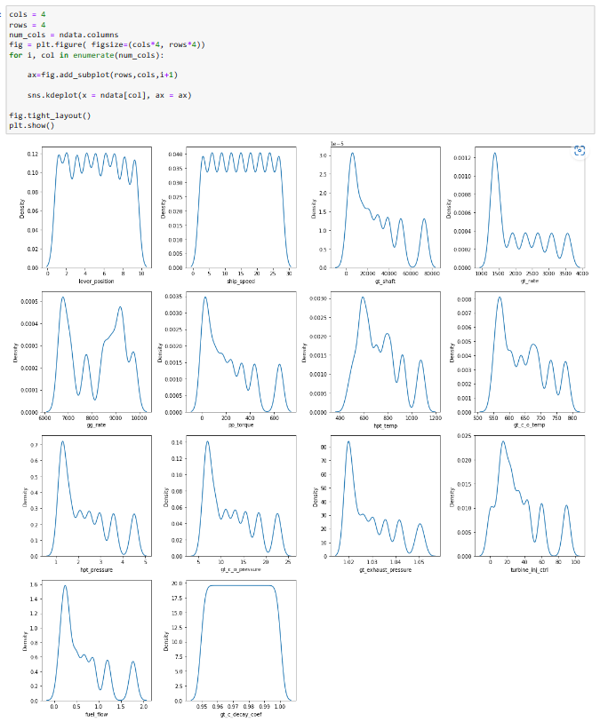
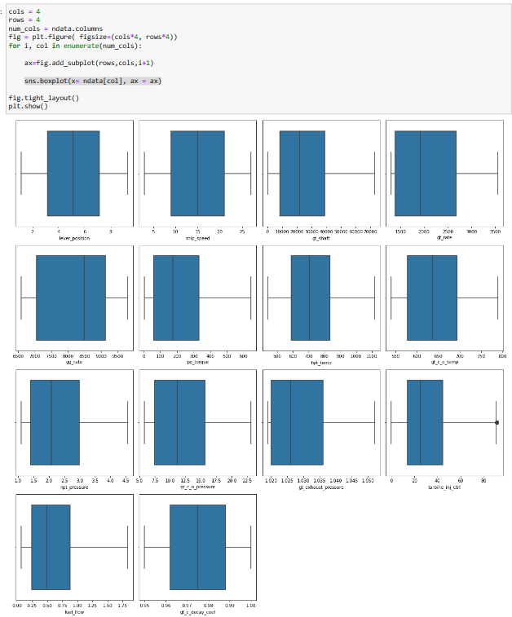
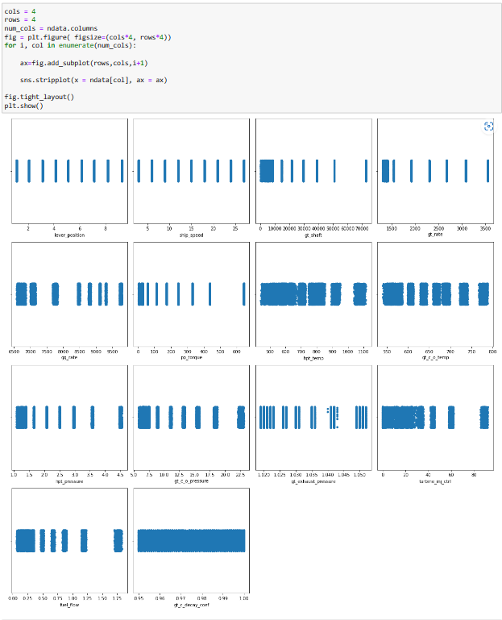
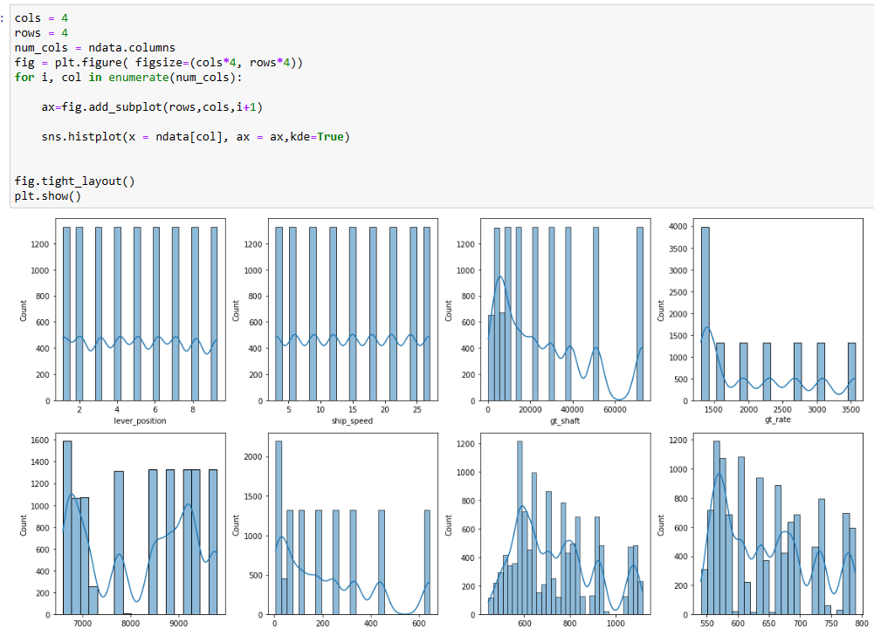

Slide 25
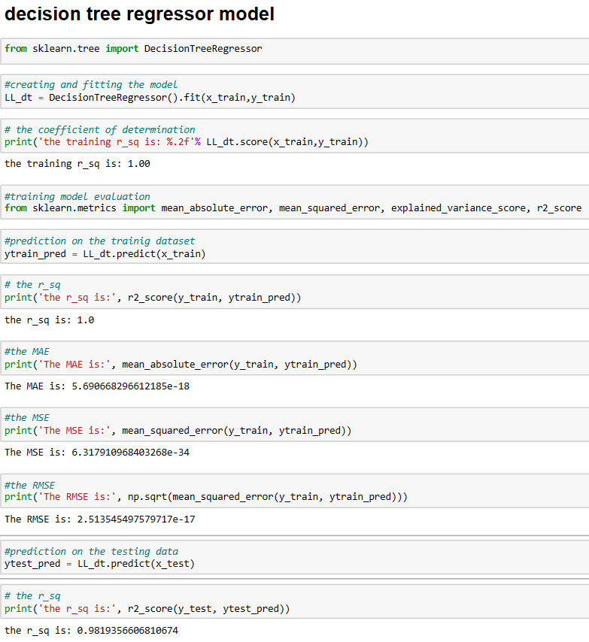
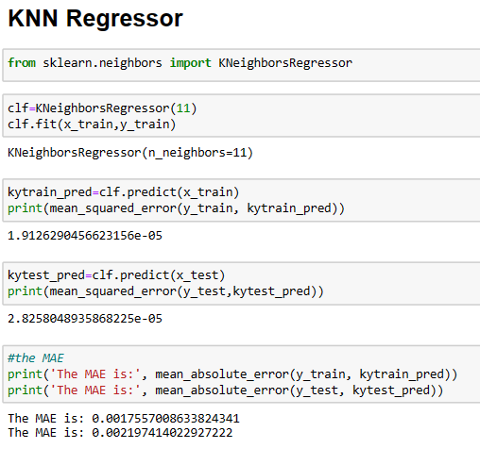
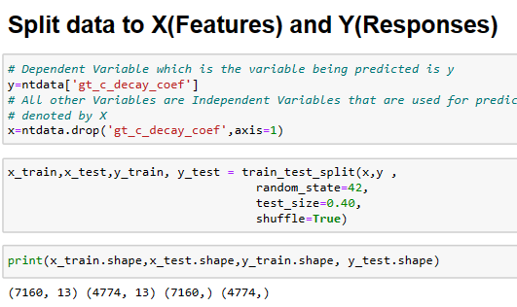
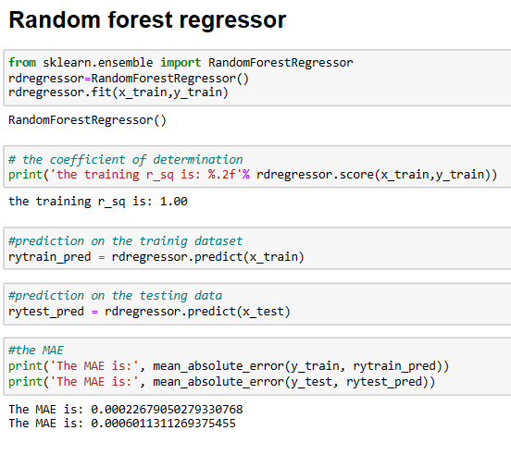
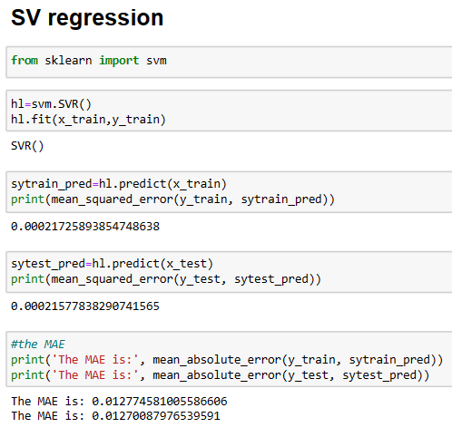
MODEL BUILDING

Slide 26
